Slide 1
House Price Prediction Modeling
- Machine Learning Project -
2019. 11. 18

Slide 2
Agenda
Project Overview
Modeling Process
Conclusion
1. Summary of prediction Result
2. Lessons Learned

Slide 3
1. Summary
I. Overview
Performed full cycle of Prediction modeling (25 features, ensemble Algorithm)
Key Questions
Overall Process & Result
Prediction
Is data clean enough to process ?
Which Features ? How many Features ?
Which Algorithms ?
Is predicted value accurate ?
Ideation
Discussion
Execution
Look-back
Redundant run between members
(Knowledge acquisition & Cross validation)
Interpre- tation
Meaning of data ? (all fields)
Understand overall modeling process ? (EDA ~ Modeling, steps/meaning/result)
Output interpretation ?
Final Result
Steps and Result
Milestone
Initial
Selection
Algorithm
Result
1.5 Weeks (11/6 ~ 11/17)
Y : 1
Y : 1
7 Algorithms
(SVM, RF, GBM, etc.)
RMSE : ($21.255 )
✽ Kaggle rank : ~20%
Understanding of Data/Biz.
(2 days)
Data Processing
(4 days)
Modeling & Lookback
(3 days)
X : 79
(1) X : 6
(2) X : 25
(3) X : 174¹⁾
1) Including dummy variabels

Slide 4
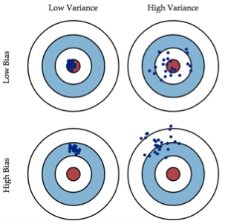
2. Prediction Modeling Scheme
I. Overview
Main concern was about Variables/Algorithms related with bias & variance
Key Consideration on House Price Prediction
Modeling Process
Key Concern
Understanding
of Project
Data upload
Understanding variables
Variables
(Nb., Quality)
Too few
Too many
EDA
Distribution (X & Y)
Correlation analysis, ..
??
Too Simple
Too Complex
Algorithm
(Best Fit)
Data Preprocessing
Imputation of NA
Variables class correction, ..
Feature Creation
Derived Variables (Space, Duration)
“Under Fitting”
“ Optimal ”
“Over Fitting”
Feature Selection
Subset selection
Feature importance, ..
Bias vs.
Variance
Modeling & Look-back
Various Algorithms
Nb. of Features used, ..

Slide 5

1. EDA & Data pre-processing
II. Modeling Process
Process & Tasks - EDA
Understanding
of Project
【 Target 】
Check Data Structure & Meaning
Refining issue data
【 Process Summary 】
EDA
Y Distribution
Skewed ⟹ Normal Distribution (Log Transformation)
Correlation
Y vs. X : Some highly correlated (ex, OverallQual, GrLivArea,.. > 0.7)
X vs. X : Some highly correlated (GarageArea vs. Gar.Cars : > 0.88, ..) ⟹ Consolidate or remove variables
Data
Preprocessing
Variables Class
Wrong class ⟹ Correction (ex, Numeric → Nominal Factor)
Feature
Creation
Feature
Selection
Missing Value
34 Variables have Missing value ⟹ Imputation of all N/A
Singularity & Outlier
Removed 2 variables (Singularity)
Removed 3 outlier Records
Modeling &
Look-back

Slide 6

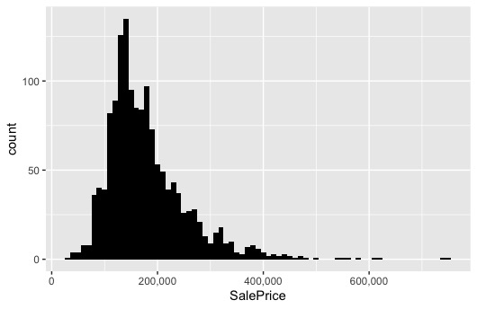
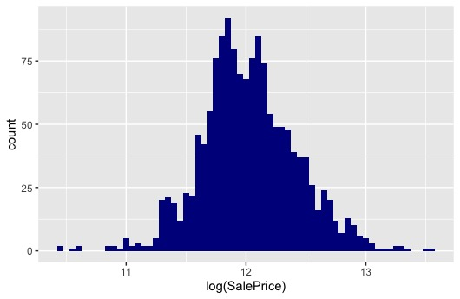
[Back-up] Y Distribution, Variable Class
Check dependent Y value (SalePrice)
The distribution of original Y value is biased to the left. (skewed)
Log transformation -> Statistically better distribution
Variables Class Check
- Correction of Class
- Initial Class
Original | Fixed | Description
Ordinal factor | numeric | Quality Variables (NA,Pr~Ex) -> 1,2,3… → Reduced by dummy variables.
Numeric | nominal factor | MSSubClass (20, 30, … 190)
Total | Numeric | Factor (Nominal) | Factor (Ordinal) | Date
81 | 31 | 31 | 15 | 4

Slide 7
[Back-up] NA Imputation, Singularity removal
Impute missing data (several cases)
Remove Singularity
Numeric missing value (11 variables) → Imputation
Exactly same value by calulation → Consolidation
Variable | How to impute
LotFrontage | regression prediction (related to LotArea)
GarageYrBlt | replace to 'YearBuilt'
MasVnrArea, etc | Impute to “0” (related to None(NA) category)
GrLivArea = 1stFlrSF + 2ndFlrSF + LowQualFinSF
(remove 3 vars)
TotalBsmtSF = BsmtFinSF1 + BsmtFinSF2 + BsmtUnfSF
(remove 3 vars)
Category is NA (23 variables) → Add ‘None’ category
(Ex, Alley {Grvl, Pave, NA} : ‘NA’ is real factor value.)

Slide 8
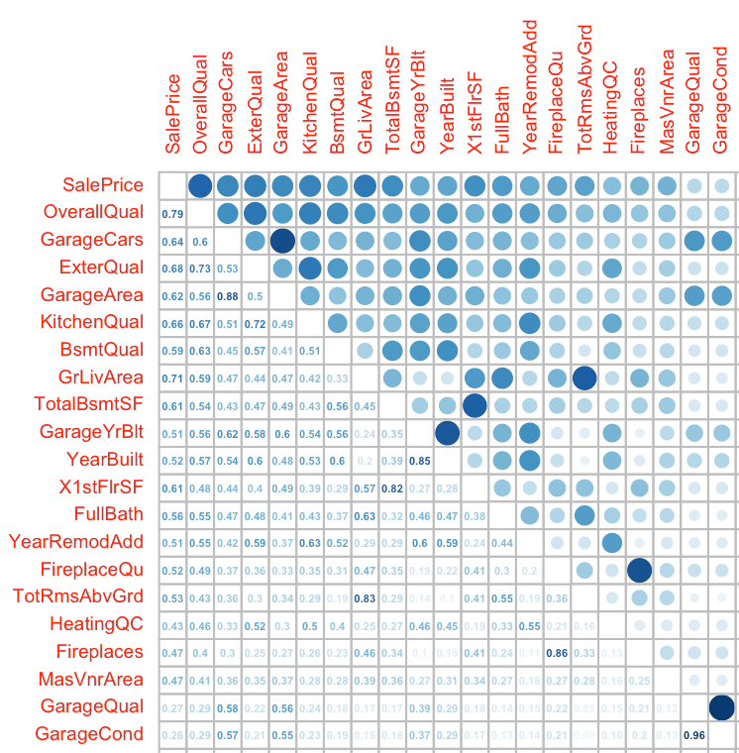
[Back-up] Correlation, Outliers
Correlations
Outliers
* Y – X
OverallQual (0.82), GrLivArea (0.71),
GarageCars(0.7), ExterQual(0.7), KitchenQual(0.7), ..
* X – X
Many variables have high correlation
(524)
(129)
ID : 524 - High X (Quality 10, GrLivArea 4,676 (Top2)) Low Y (Sale Price $184,750)
ID : 129 - High X (Quality 10, GrLivArea 5632 (Top 1)) Low Y (Sale Price $160,000)
Others

Slide 9
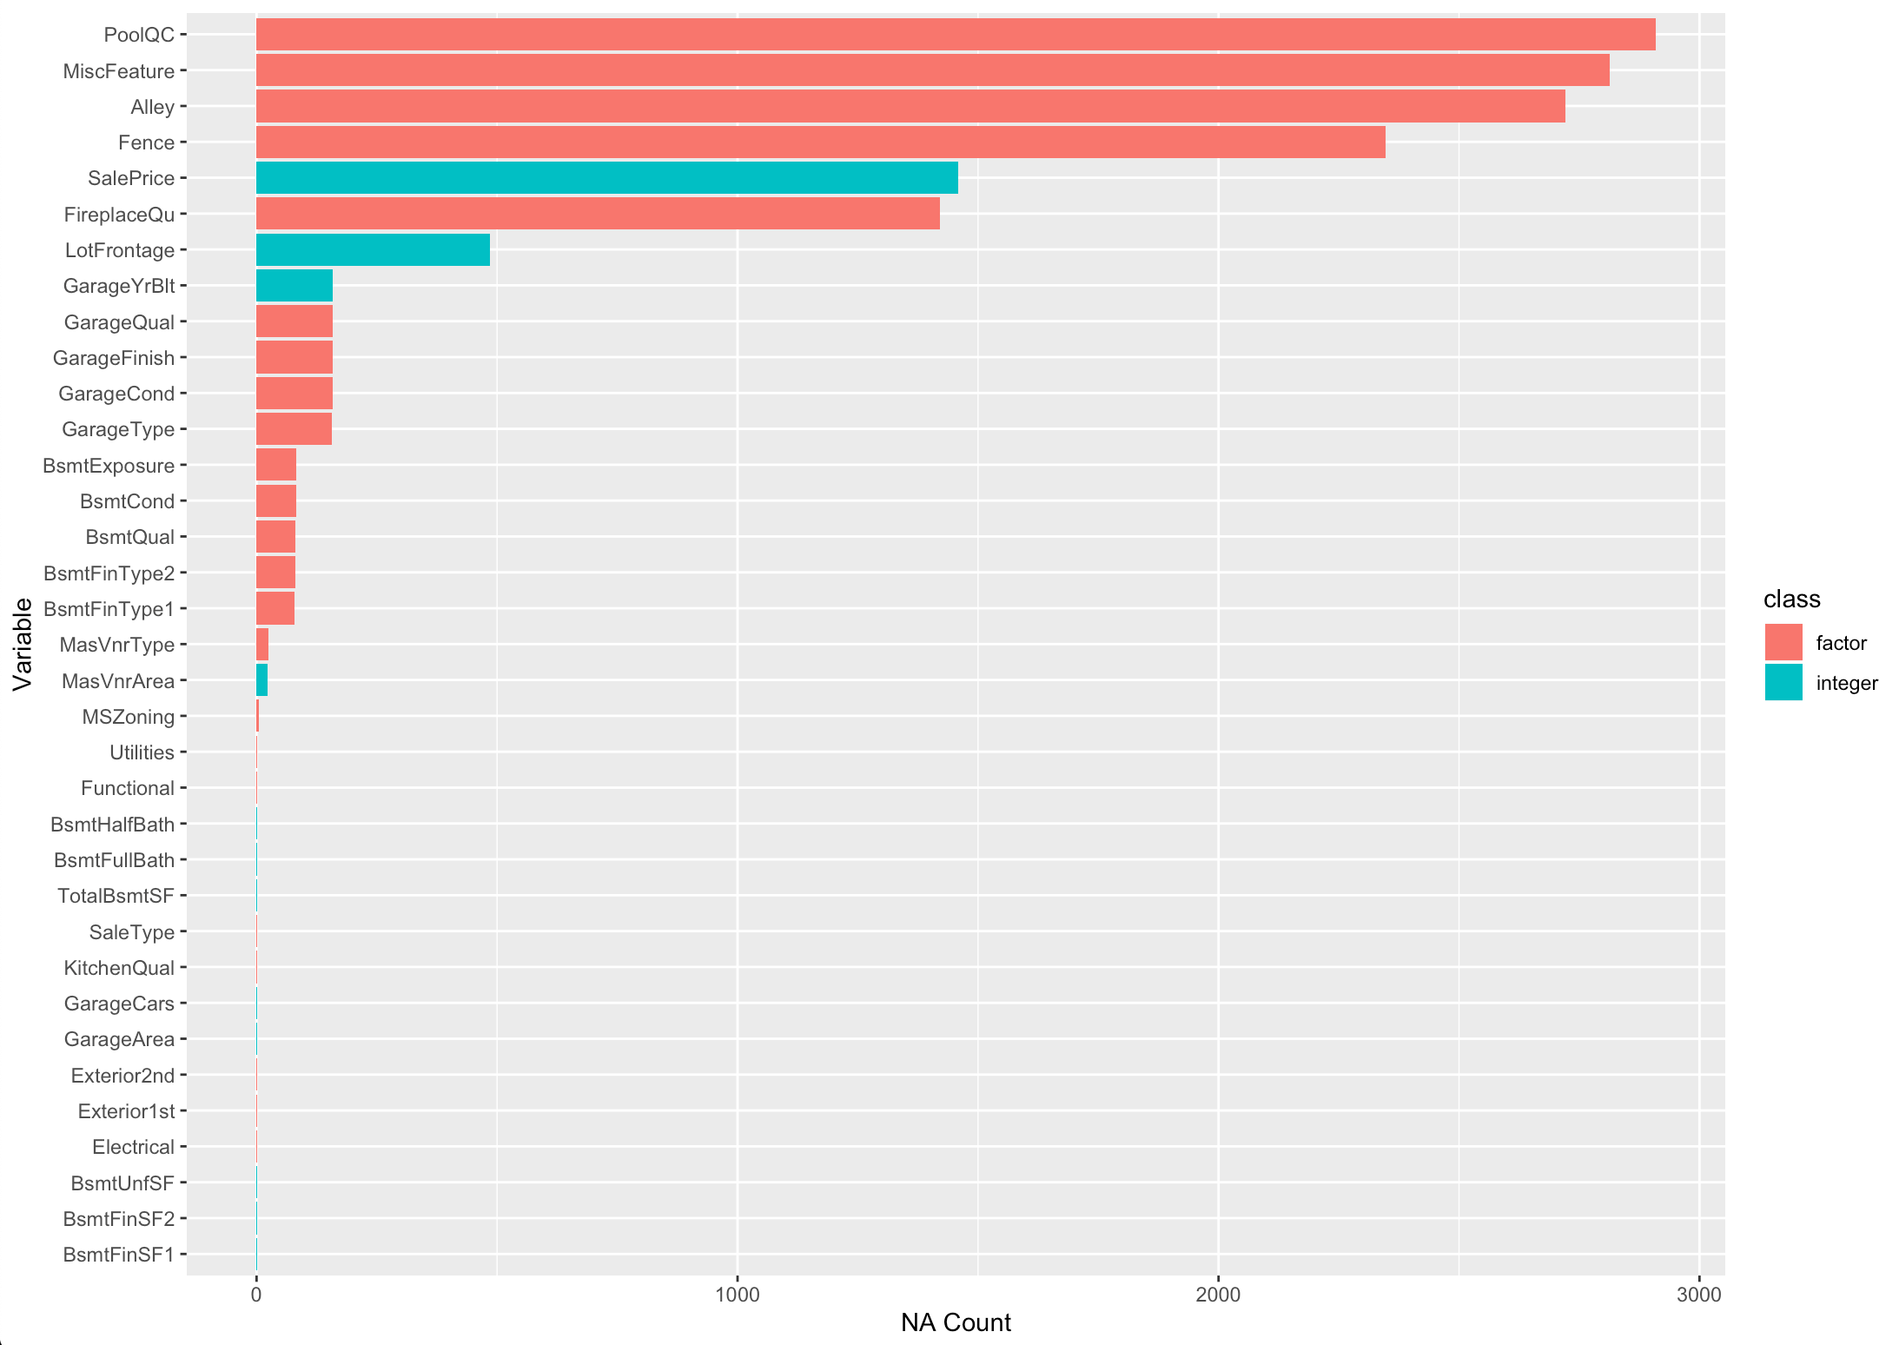
[Back-up] NA Variables plot

Slide 10
2. Feature Engineering
II. Modeling Process
Process & Tasks - Feature Creation & Selection
Understanding
of Project
【 Target 】
Creation of derived features
Key features screening
【 Process Summary 】
EDA
Feature Creation
Consolidation of related features (Total space : Ground floor, Basement, ..)
Creation of meaningful period features (Age of house, Age of remodeled)
Data
Preprocessing
Feature Selection
Feature
Creation
Selection from 174 features (Including dummified variables)
➀ Subset Selection
➁ Lasso Penalization
➂ Feature importance
Feature
Selection
8 Stepwise cases (AIC/BIC & Forward/Backward, ..)
76 features selected
Regularization (best lambda : 0.01)
42 features selected
6 Algorithms (SVM, mRMR, RF, ..)
Feature grouping by Importance
Modeling &
Look-back

Slide 11
[Back-up] Feature Creation
Creation of Features
House space feature consolidation (features deleted after consolidation)
* Tot.Space (New Feature) = TotalBsmtSF + GrLivArea + GarageArea
※ Verification (Check for the Correlation with Y)
variable | correlation (w/ SalePrice)
Tot.Space | 0.8528168
TotalBsmtSF | 0.6473571
GrLivArea | 0.7250041
GarageArea | 0.6575029
* Porch = OpenPorch + EnclosedPorch + X3SsnPorch + ScreenPorch
Period Feature creation (features deleted after creation)
* House Age ⟹ built.period (New feature) = YrSold – YearBuilt
* Remodeled Age ⟹ remod.period (New feature) = YrSold - YearRemodAdd

Slide 12
[Back-up] Feature Selection (1/2)
Feature Selection
Subset Selection : Stepwise feature selection
AIC : Forward / Backward / Both(empty / full) Selection
BIC : Forward / Backward / Both(empty / full) Selection
[ Result ]
Similar result among 8 cases (Importance features : Total space, OverallQual,..)
76 features selected (P-value)
※ Prediction result was not good with 76 features (In final step)

Slide 13
[Back-up] Feature Selection (2/2)
Lasso Penalization
Regularization (Best Lambda : 0.01)
[ Lasso Result ]
42 features selected
※ Prediction result was not good
Feature importance by various algorithms
PLS (Partial Least Square)
Random Forest
XGBoost
GBM
SVM
mRMR (Minimum Redundancy, Maximum Relevance)
(After above 3 3teps) Feature Grouping by overall Importance
Top Tier (6)
2nd Tier (19)
Others
tot.space, OverallQual, KitchenQual, built.period, remod.period, fireplaces
LotArea, OverallCond, CentralAir.Y, FullBath, GarageCars, GarageYrBlt, ..
3rd Tier (21 variables) 4th Tier (22 variables) Garbage (Other)
Create Final Feature Group for Modeling (Training)
Top Tier
(6 Features)
Important Tier
(25 Features : Top + 2nd)
All Features (174 Features)

Slide 14
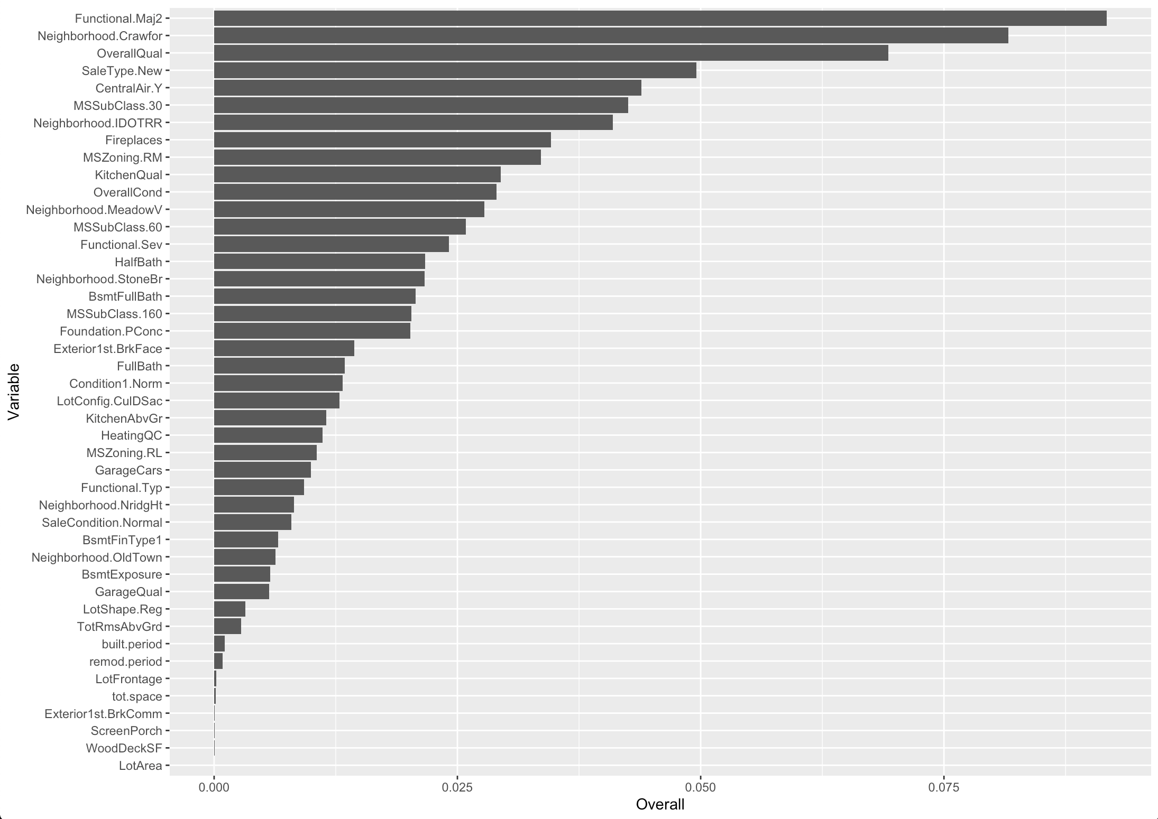
[Appendix] Variable Importance of Lasso

Slide 15
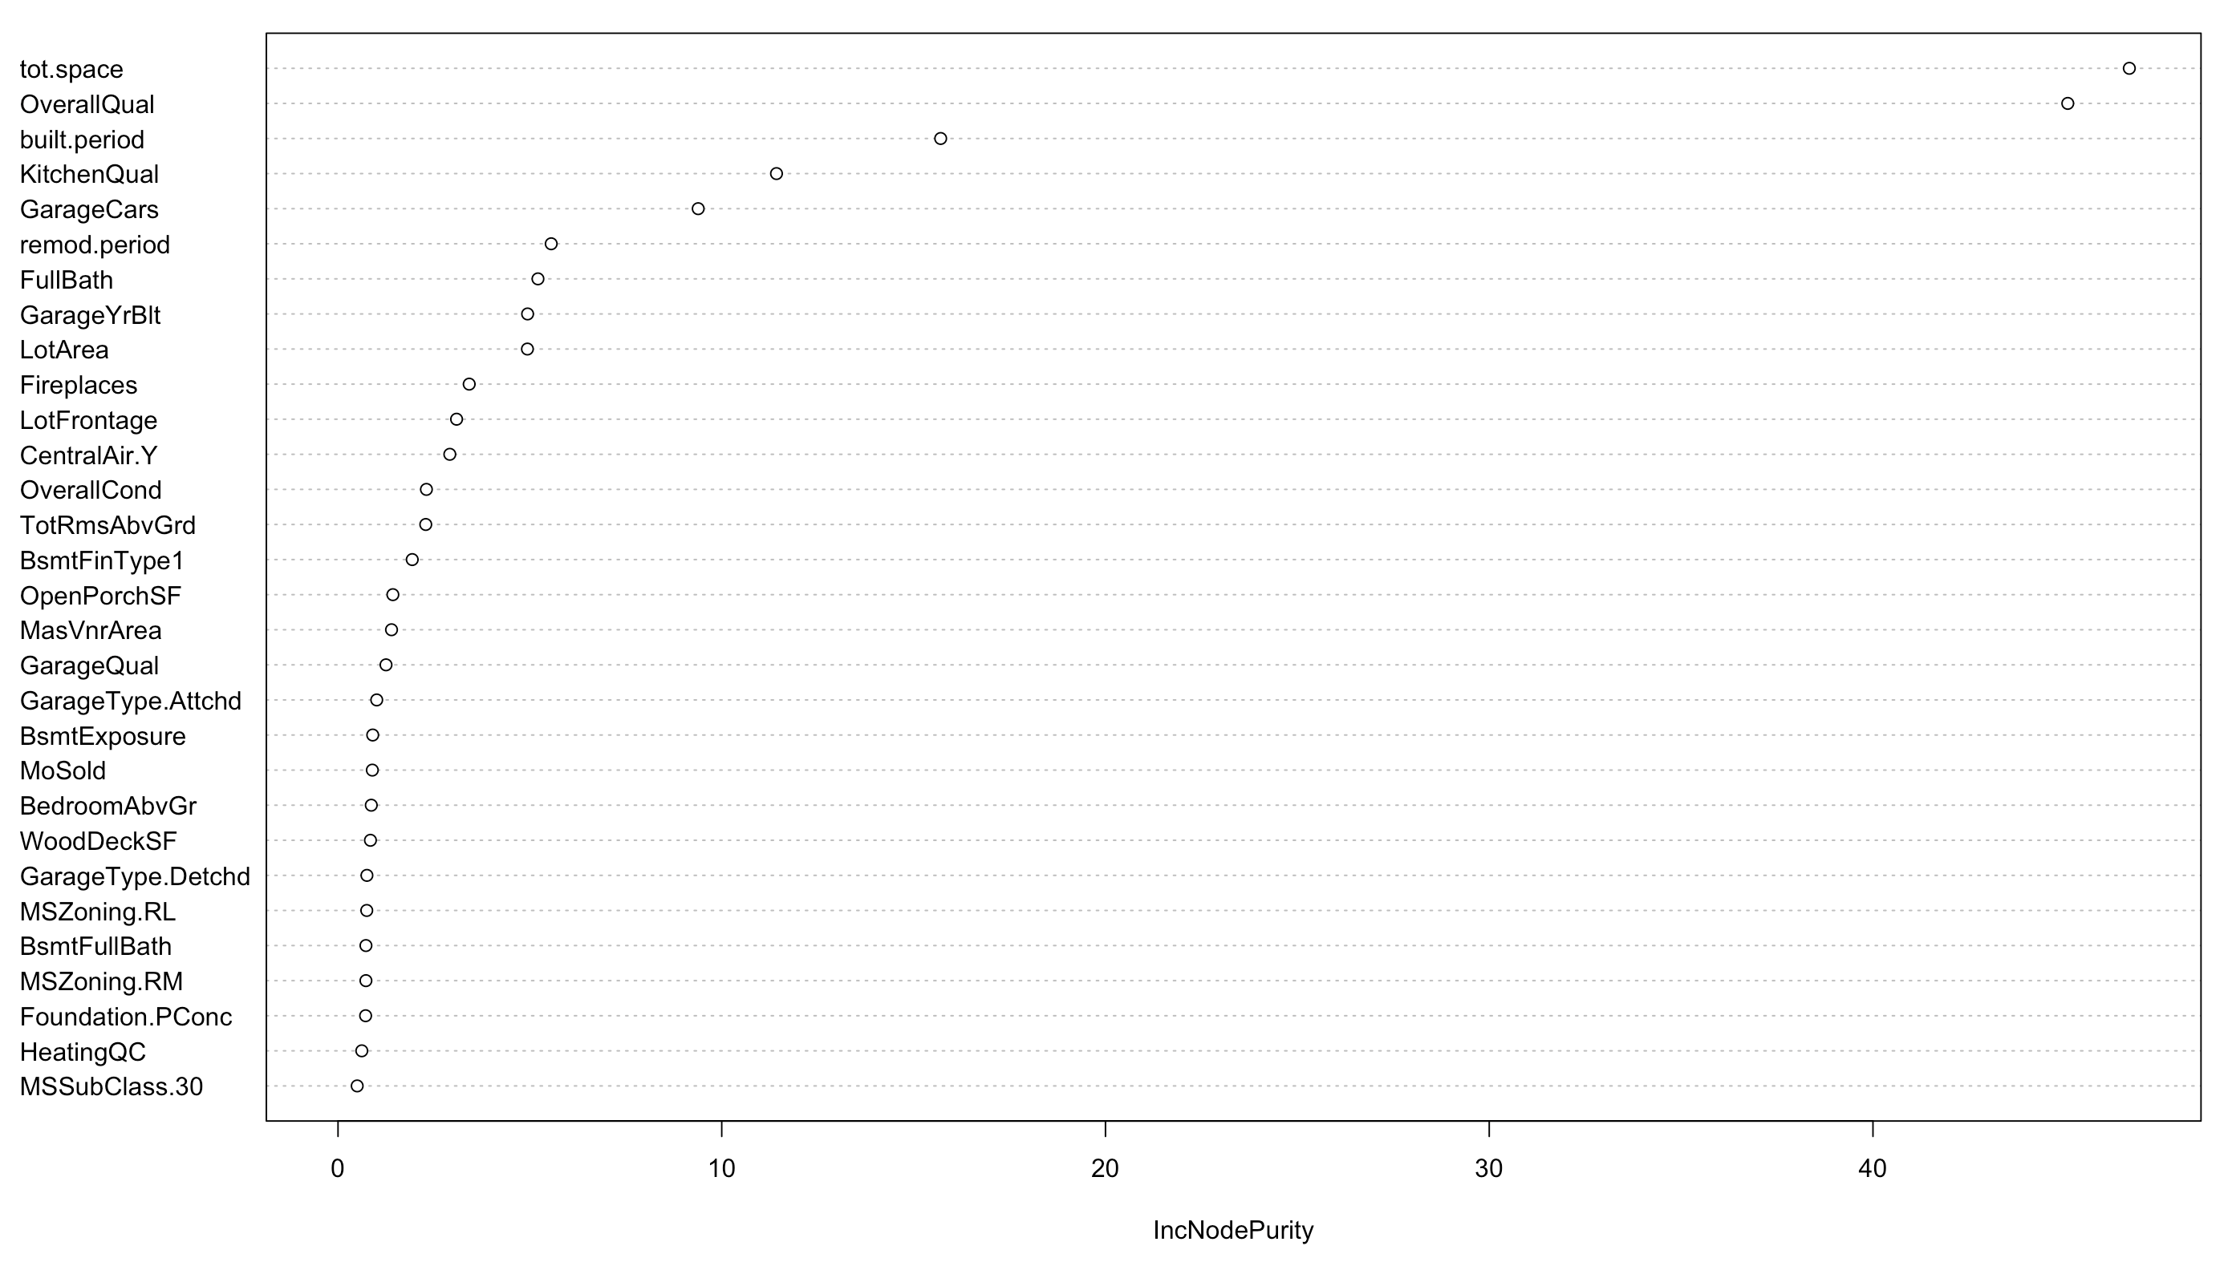
[Appendix] Variable Importance of Random Forest

Slide 16
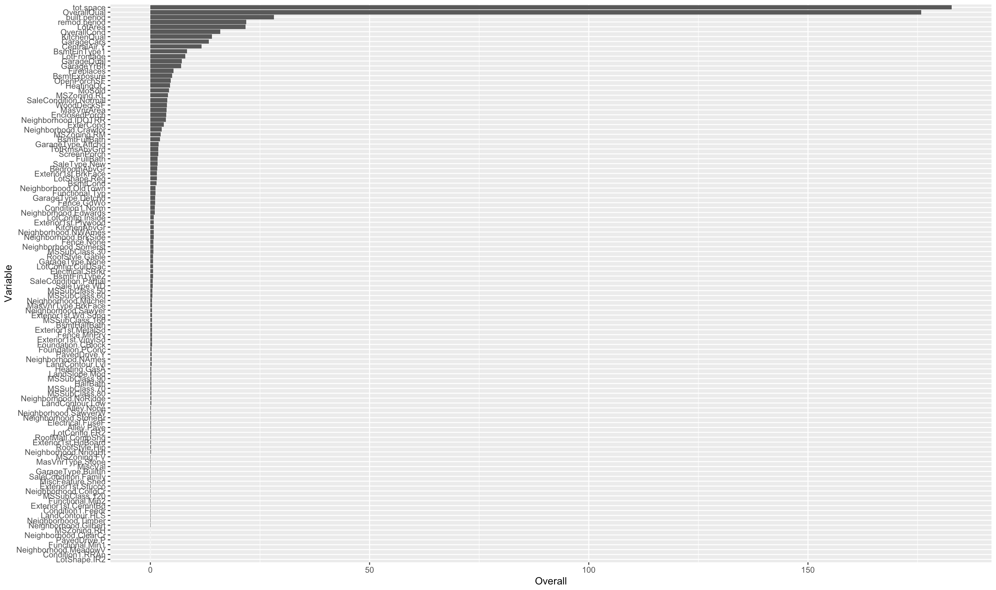
[Appendix] Variable Importance of GBM

Slide 17
3. Modeling & Look-back
II. Modeling Process
Process & Tasks - Modeling & Look-back
Understanding
of Project
【 Target 】
Create Best model (Cross Validation, Hyper-parameter, ..)
【 Process Summary 】
EDA
Iteration
Data
Preprocessing
LM
Lasso
All Variables
PLS
Feature
Creation
RMSE
Top Tier
SVM
RF
RMSLE
Feature
Selection
Top + 2nd Tier
GBM
Evaluation
XGBoost
Modeling &
Look-back
K-Fold Cross Validation / Grid Search

Slide 18

[Back-up] Prediction Result
Model Fitting & Prediction (Example of XGBoost algorithm)
Prediction Result (by feature group & by Algorithm)
Grid Search
max_depth (default: 6) $→$ c(3, 6, 9)
min_child_weight (default: 1) $→$ c(1, 3, 5)
Gamma (default: 0) $→$ c(0, 0.3, 1, 2)
Eta (default: 0.3) $→$ c(0.1, 0.3, 1)
K-Fold Cross Validation
Find best round with hyper parameters.
Model | Feature Group (Nb. of features)
 | Top (6) | Important (25) | All (174)
Linear Regression | 0.130 | 0.117 | 0.114
PLS | 0.168 | 0.177 | 0.195
Lasso Regression | 0.130 | 0.118 | 0.114
Random Forest | 0.125 | 0.115 | 0.117
SVM | 0.131 | 0.117 | 0.111
GBM | 0.129 | 0.111 | 0.108
XGBoost | 0.142 | 0.117 | 0.114
Average | 0.136 | 0.125 | 0.125
Final Model (RF+XGBoost+GBM) |  | 0.111 ($21,255)
RMSLE (RMSE)
Default Parameter | After Tuning
0.16 ($27,748.2) | 0.11 ($19,543.2)
In General
Best score algorithm : RF, GBM, XGBoost…
Best Feature group : Important(25), all (174)
※ Suspected Multicollinearity in all feature group

Slide 19
1. Summary of Prediction Result
III. Conclusion
Final Model : 25 Features, Ensemble(SVM, GBM, XGBoost), RMSE $21,255
Model complexity ↑ (Accuracy ↑ , Interpretability ↓¹⁾)
Linear Regression
(LM, PLS, Lasso, Ridge)
Kernal Based
(SVM)
Ensemble
(RF, GBM, XGBoost)
Summary of result
[ Case ]
Top Priority Features Only
(7 Features)
※ All cases : Training set (80:20), 10-folds cross validation
1
Model complexity ↑ (Nb. of Features↑)
Too simple model to predict well (Model Complexity ↓)
Prediction Result - RMSE : 00 ~ 00
☛ Accuracy is relatively low
1
[ Case ]
2
Important Features
(25 Features)
2
Most Proper case
Our final Model (Lowest RMSE) - Nb. of features : 25 Features - Algorithm : (RF+XGBoost+GBM) - RMSE : $21,255 (RMSLE 0.111)
Prediction Result - RMSE : 00 ~ 00
☛ Accuracy is relatively high
All Features
(162 Features)
3
Prediction Result - RMSE : 00 ~ 00
☛ Accuracy is high, but expected high error in test data-set (overfitting)
[ Case ]
3
Too complex model to predict well (Multicollinearity ↑, Too fit on training data set)
1) Reference : https://towardsdatascience.com

Slide 20
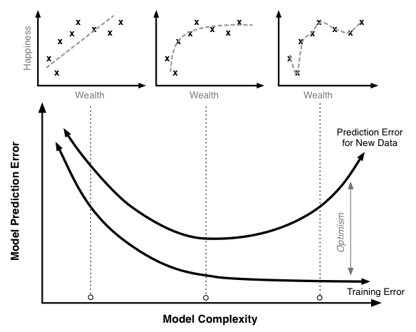

2. Lessons Learned
III. Conclusion
Our Conclusion
Key is to combine “Proper Nb. of Features(Qualified)” & “Proper Algorithm”
1
2
3
Too few variables
Too simple algorithm
Well
Balanced
Too many variables
Too complex algorithm
[ Lessons Learned ]
As the complexity of model is …
Increased ➔ training error ↓, test error ↑ (Over- fitting)
Decreased ➔ training & tests error ↑ (Under-fitting)
How to find proper complexity is key to success !!
House Price
Features / Algorithm
Features / Algorithm
Features / Algorithm
Ture Prediction Error Minimize!!
Optimism
※ More Idea
Timing of sales (Time series)
Politics & Regulation (Non-Structured data)
Big Event (Non-Structured data)
Model complexity

Slide 21
Wrap-up

